Slide 1
Project Title: An AI-Enabled Healthcare Platform for Unified Patient Data Management, Disease Prediction and Personalized Treatment
The Tech Titans | Hackathon 2025

Slide 2
Problem Statement
Healthcare data is fragmented across multiple, non-interoperable systems.
Lack of unified access limits diagnosis accuracy and personalized treatment.
Patients and clinicians face inefficiency, redundant testing, and safety risks.
Urgent need for integration as healthcare shifts from reactive to predictive.

Slide 3
Solution Overview
AI-powered platform to unify patient data (EHRs, medical images, clinical notes).
Uses ClinicalBERT (NLP) for text, CNNs for images, and ensemble fusion models for prediction.
Provides chronic disease risk assessment, early disease prediction, and personalized treatment recommendations.
Built with HL7-FHIR interoperability standards for scalability.

Slide 4
Desirability
Target Users: Doctors, hospitals, research institutions.
Pain Point Solved: Eliminates data silos, improves decision-making.
Impact: Safer, faster, and more accurate treatment; empowers proactive healthcare

Slide 5
Feasibility
Backend: Flask
Database: SQLite (via SQLAlchemy)
Machine Learning: scikit-learn (Random Forest model)
Data Handling: Pandas, NumPy
String Matching: fuzzywuzzy, python-Levenshtein
Authentication & Security: Werkzeug (password hashing), Flask sessions
Frontend: HTML, CSS, Jinja2 templates

Slide 6
Viability
Model: SaaS platform for hospitals & clinics.
Market Demand: Rising global push for AI in healthcare.
Scalability: Expandable to real-time clinical deployment.
Revenue Stream: Licensing, hospital subscriptions, research partnerships.

Slide 7
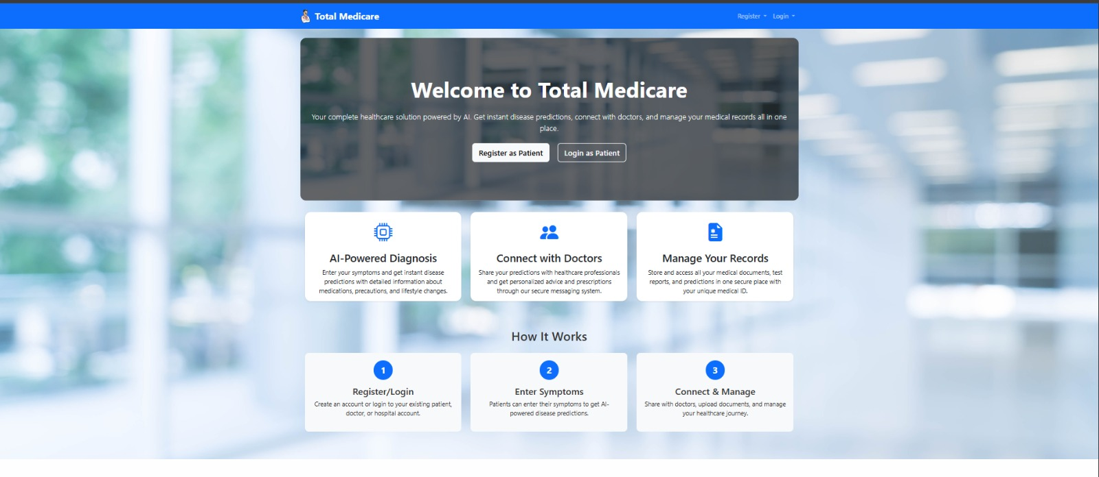
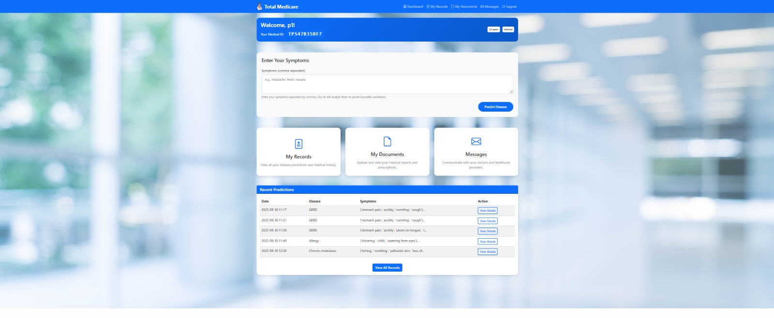
Prototype / Demo

Slide 8
Roadmap
Built So Far: Symptom-based prediction engine with backend API.
Next 30 Days: Expand multimodal integration Next 60 Days: Develop clinical dashboard UI.
Next 90 Days: End-to-end prototype with real-world datasets.
Future Vision: Deployable precision medicine platform.

Slide 9
Team & Roles
Adithya Kiran V – Full stack & Cloud.
Arun V L – Full stack, System Architecture & Presentation.
Dhanya Jayaraman – Data Engineer & Model Developer.
This team is capable of executing this project because the team combines strong expertise in AI, data science, and system design, backed by hands-on project experience in machine learning.

Slide 10
Ask
• Mentorship in clinical deployment.

Slide 11
Thank You
Adithya Kiran V – adithya44kiran@gmail.com
LinkedIn - https://www.linkedin.com/in/adithya-kiran-v-786484257/
GitHub - https://github.com/adithyakiran47
Arun V L – vlapvrvk@gmail.com
LinkedIn - https://www.linkedin.com/in/vl-arun-46630b24b/
GitHub - https://github.com/VL-ARUN
Dhanya Jayaraman – dhanya.jayaraman05@gmail.com
LinkedIn – https://www.linkedin.com/in/dhanya-jayaraman-078a862b4/
GitHub - https://github.com/dhanyajay
• "Towards Precision Healthcare with AI"

